Slide 1
Machine Learning in Traffic Classification of SDN Based Networks Imarticus Learning - Capstone Project Review
Somasundaram S (811719104095)
somusonthos@gmail.com
August 4th, 2022

Slide 2
Problem Definition
The classification of traffic flows in today’s IP networks has became an important research area with the adoption of Machine Learning (ML) techniques and Software Defined Networking (SDN) principles. Traditional methodologies including identifying traffic based on port number and payload inspection are not effective due to the dynamic and encrypted nature of current traffic. This project will attempt to utilize Supervised and Unsupervised ML algorithms to classify flows based on packet and Byte information

Slide 3
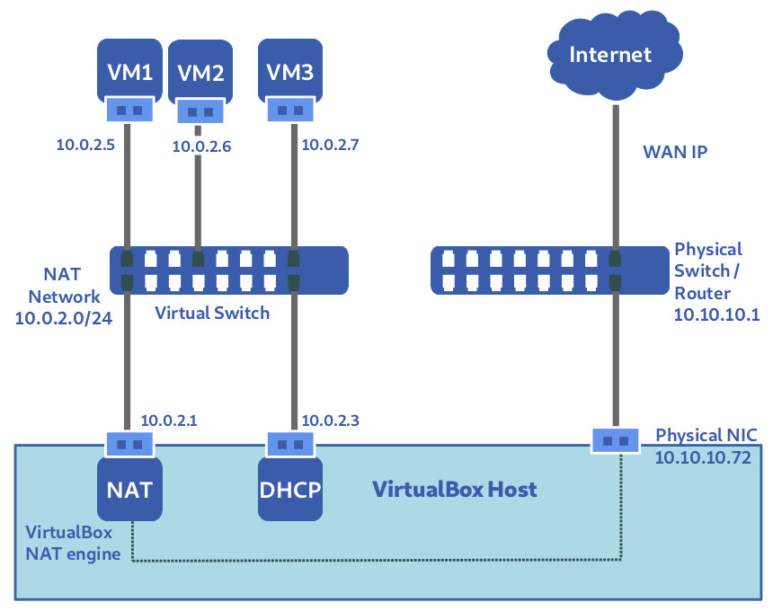
Network Topology

Slide 4
Process
Build Topology
Simulate Traffic Flows
Collect Training Data
Train Models
Use Models Real Time
Setup VirtualBox with Host, Switch Controller VM
Create internal network as underlay network
Configure overlay network
Use simulation tools to send various traffic flows between hosts
Modify controller scripts to output required data
Write script to collect output of controller monitoring application
Using Jupyter Notebook, train and test supervised and unsupervised Machine Learning models
Using models created in Notebook, classify traffic real time from data given

Slide 5

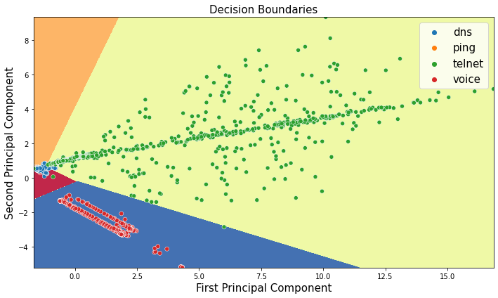
Supervised vs. Unsupervised Learning
Logistic Regression
K-Means Clustering

Slide 6
Conslusion
In this classification problem, with input features as a variety of parameters, and the target variable as a categorical variable, predicting the correct network traffic.
The highest accuracy of the previous methods was 96% but the accuracy of the proposed method is 99.9%

